Slide 1
Data Collection Workshop
Zack Dai

Slide 2
Ways of data collection
Surveys, interviews or observation
Library source
Internal database
Web Scraping
Purchase data
Data API
Open-Source Data

Slide 3
Web technology basics

Slide 4
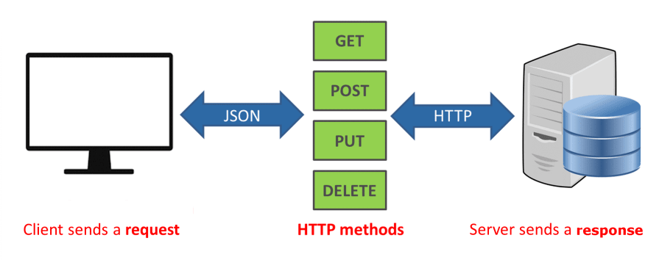
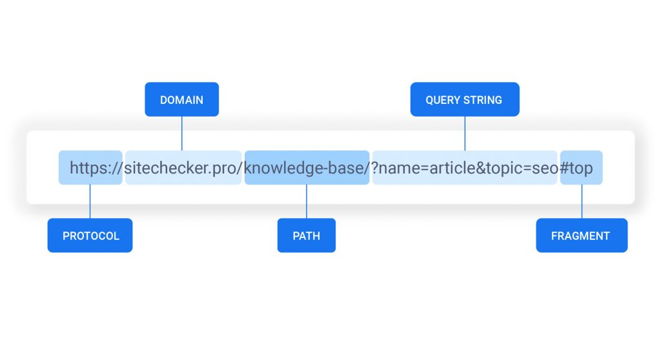
Understand URL and Http request
GET requests
Sent when URL is submitted in the browser location bar or a user clicks a link
Send data in the URL and query string
Reloadable
Can bookmark
Used for read-only operations
View, search, sort, or filter data
Data does not change
POST requests
Sent when web form is submitted
Send data in the URL and as an attachment
Semi-reloadable (prompt to send data again)
Can not bookmark
Used for write operations
Create, update, or delete data
Data does change

Slide 5
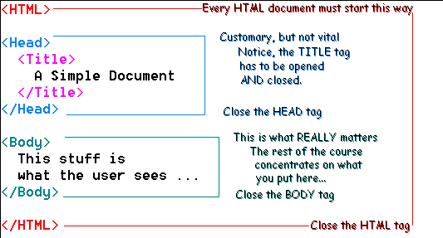
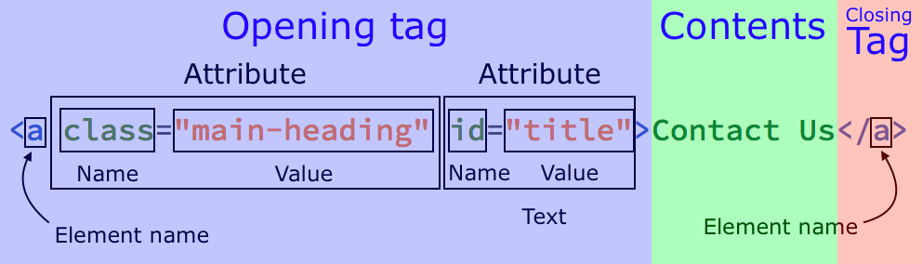
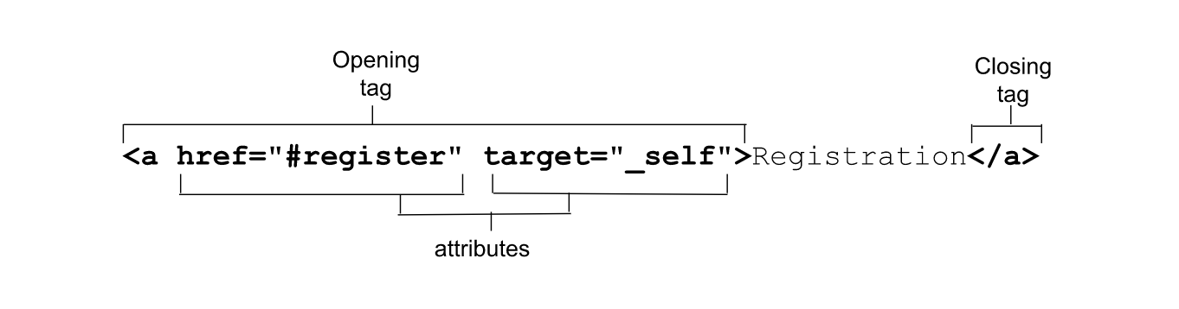
HTML Structures
HTML consisted by elements of TAGs
All HTML elements can have attributes
Attributes provide additional information about elements
Attributes are always specified in the start tag
Attributes usually come in name/value pairs like: name="value“
Most common tags are class, id and href

Slide 6
Web scraping

Slide 7
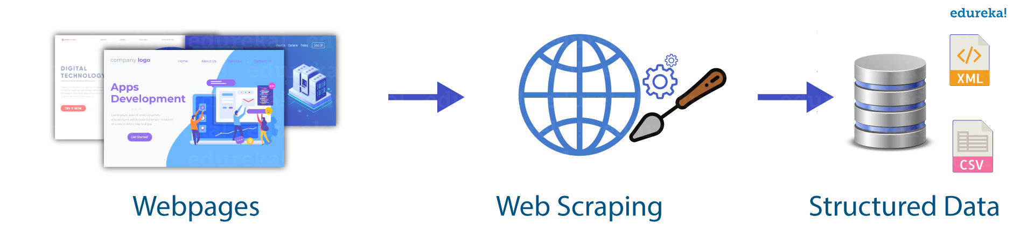
Web Scraping Overview
Find pattern of the web page/website structure. (Understand the web designer)
Build scraping processes
Extract information

Slide 8
Common Tools
Coding
Python: requests, beautifulsoop, scrapy, httpx, selenium, playwright etc
JavaScript: Axios, Nightmare, Cheerio, Puppeteer
Go: Colly, Goquery
No Coding
Webscraper.io
Octoparse
Bright Data
Automa
etc

Slide 9
CSS Selector
What is CSS selector?
CSS selectors are patterns used to select and style HTML elements.
They define which elements the CSS rules will apply to.
CSS is used for web designer to locate element and define styles.
Type of CSS selector
Universal Selector (*): Selects all elements on a page.
Type Selector (Element Selector): Selects elements based on their HTML tag name (e.g., div, p, h1).
Class Selector (.classname): Selects elements with a specific class attribute (e.g., .container).
ID Selector (#id): Selects a single element with a specific id attribute (e.g., #header).
Descendant Selector (whitespace): Selects an element that is a descendant of another element (e.g., ul li selects all li elements inside ul).
Child Selector (>): Selects an element that is a direct child of another element (e.g., ul > li selects li elements that are direct children of ul).
Adjacent Sibling Selector (+): Selects an element that is immediately preceded by a specific element (e.g., h2 + p selects a p element that directly follows an h2).
Attribute Selector ([attribute=value]): Selects elements with a specific attribute and value (e.g., [type="text"] selects input elements with type="text").
CSS Practice: https://www.w3schools.com/css/css_selectors.asp

Slide 10
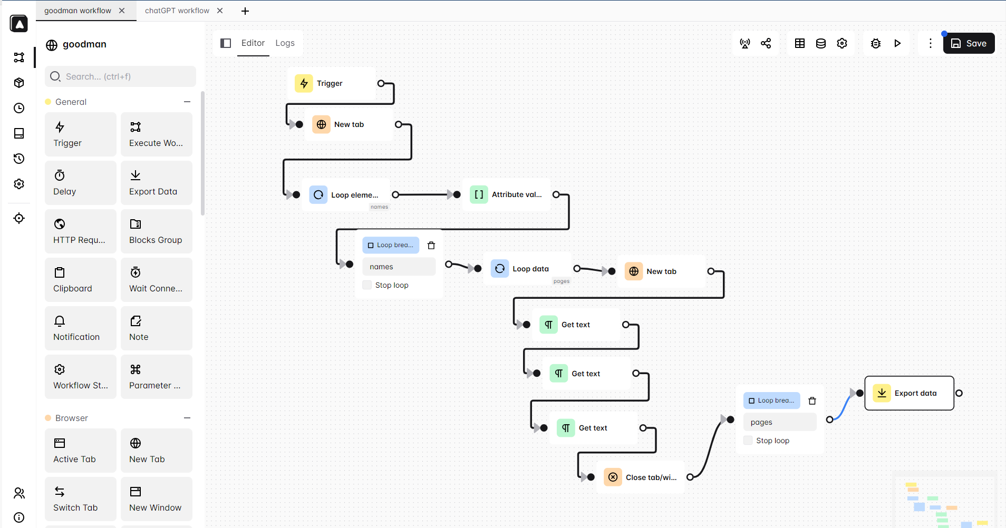
Automa: No Code Open-Source Scraper
Official Site: https://www.automa.site/
Github: https://github.com/AutomaApp/automa

Slide 11

Example 1: Google Search
Record workflow
Use new tab to search in google
Use get text to get result
Build table for data exporting
Scroll down
Sample Graph: https://github.com/Goodman-School/Scraping_with_automa/raw/main/examples/1.Google.automa.json

Slide 12

Example 2: Goodman directory
Get link lists
Reuse saved data
Open/close tabs
Sample Graph: https://github.com/Goodman-School/Scraping_with_automa/raw/main/examples/GoodmanList.automa.json

Slide 13

Practice: Meta(Facebook) Search
Try it yourself!
Sample Graph: https://github.com/Goodman-School/Scraping_with_automa/raw/main/examples/Meta.automa.json

Slide 14
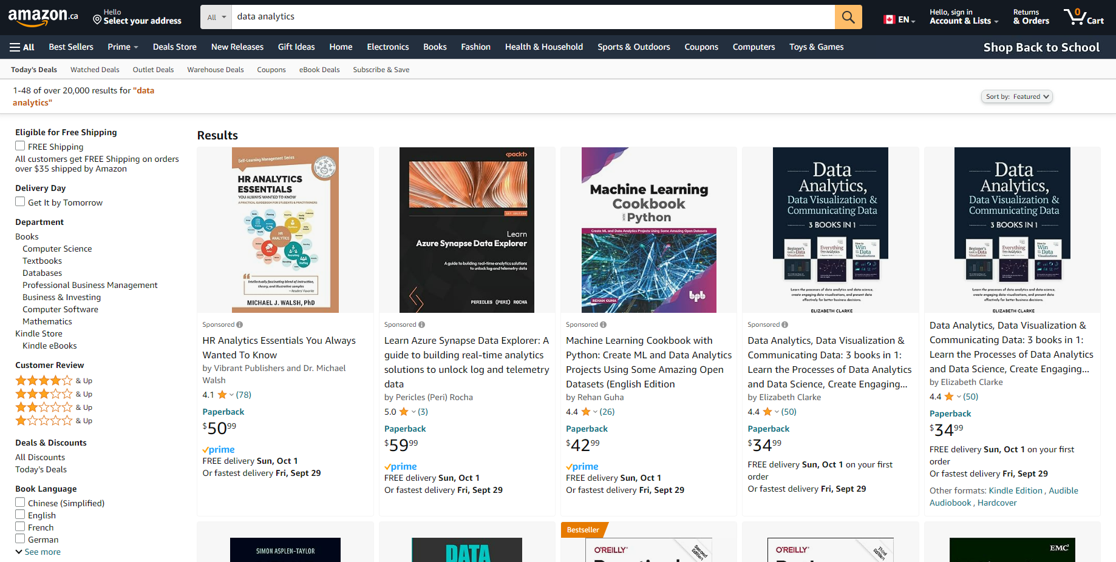
Challenge Practice: Amazon
More functions, refer documentation https://docs.automa.site/

Slide 15
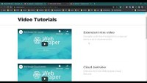
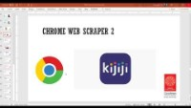
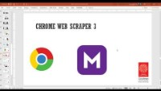
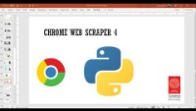
Recording of older version of this workshop
Other tools based

Slide 16
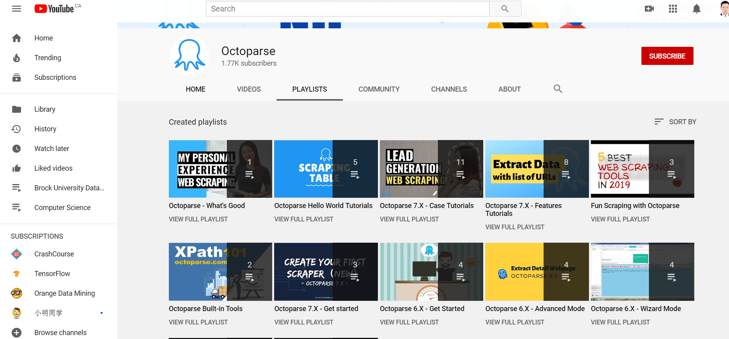
Octoparse Tutorials
https://www.youtube.com/channel/UCweDWm1QY2G67SDAKX7nreg/playlists

Slide 17
Other Data Sources

Slide 18
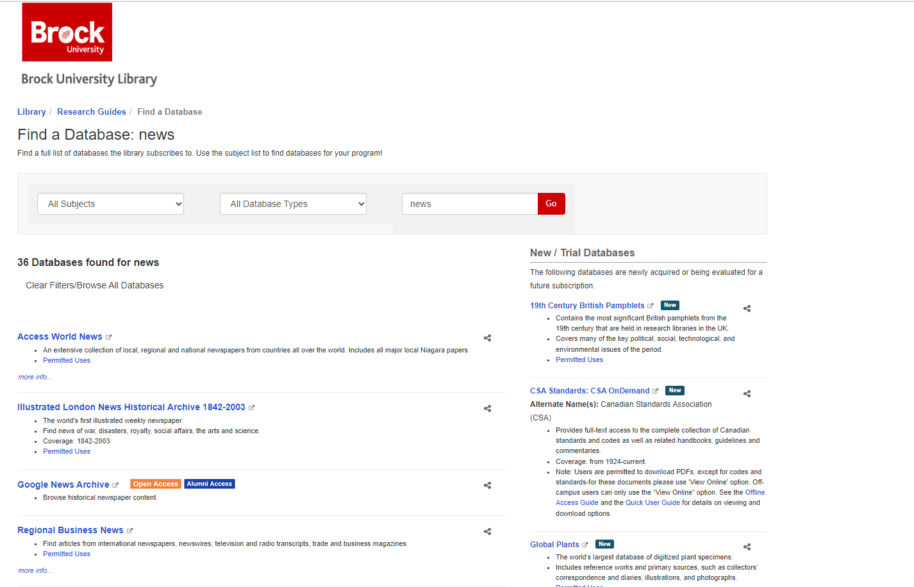
Brock Library Database
https://researchguides.library.brocku.ca/az.php?q=news&p=1

Slide 19
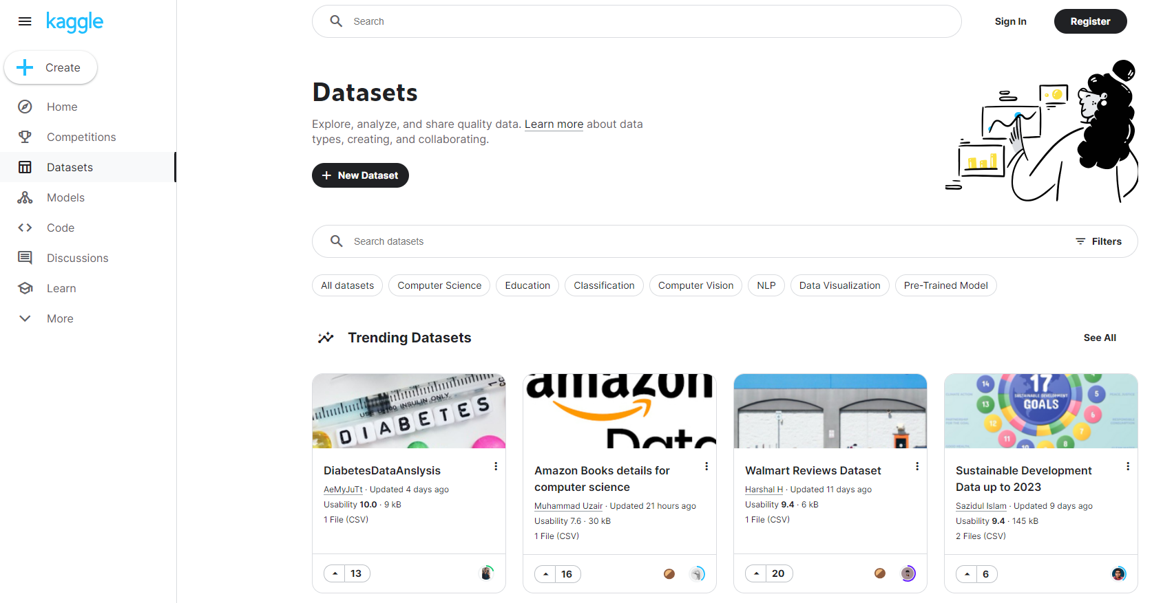
Kaggle Open Data
https://www.kaggle.com/datasets

Slide 20
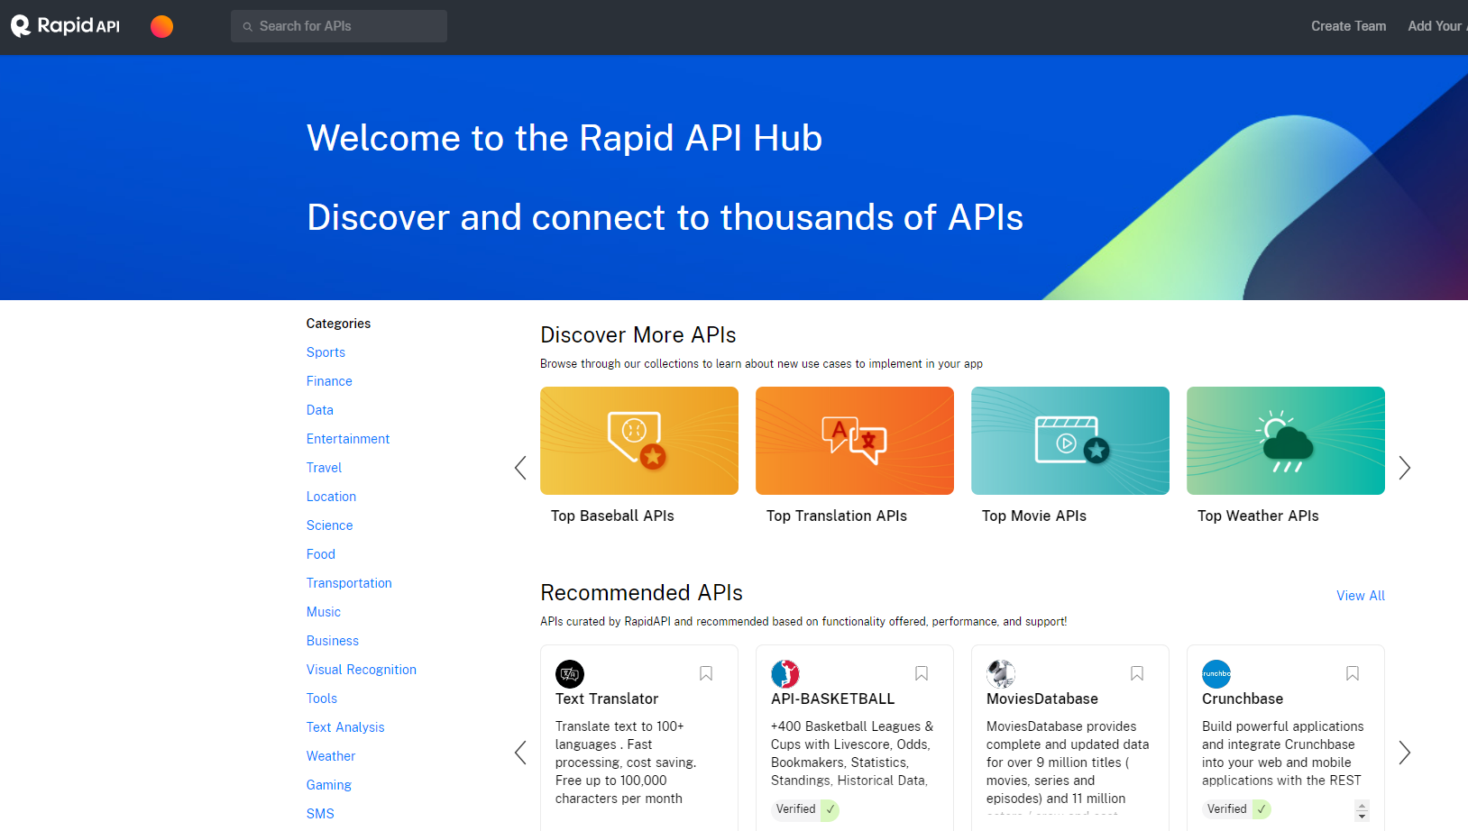
Rapid API
https://rapidapi.com/hub

Slide 21
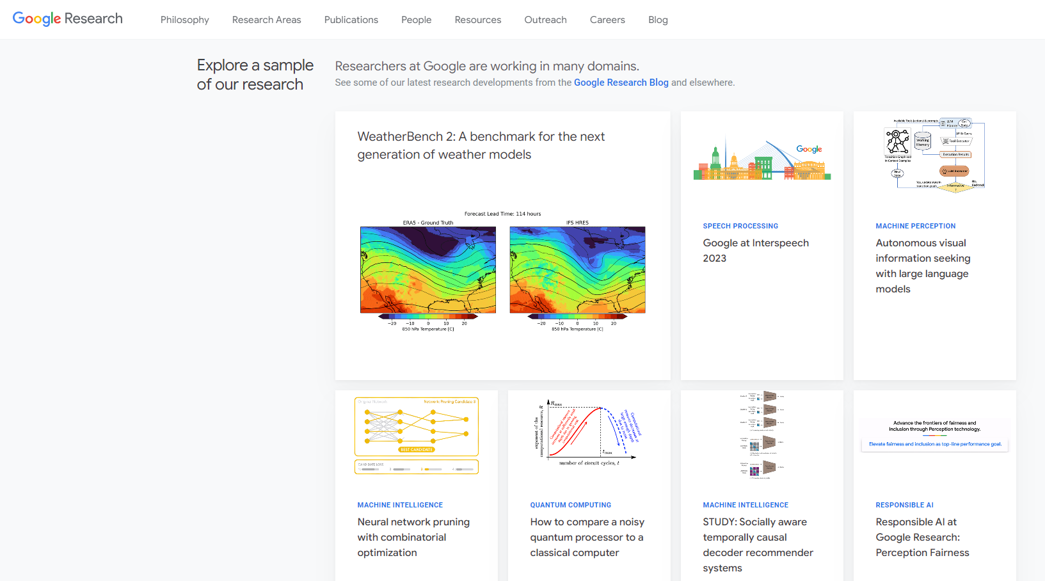
Google Research
https://research.google/

